Slide 1
Data types & Arrays
Visual Basic

Slide 2
Table OF contents
Lecture context
What variables can store
Numeric types
Non-Numeric types
Variable scoping
Grouping variables
Array indexing
Array visualization
Code to fill array with data
Code to fill a dynamic array
Working with bounds

Slide 3
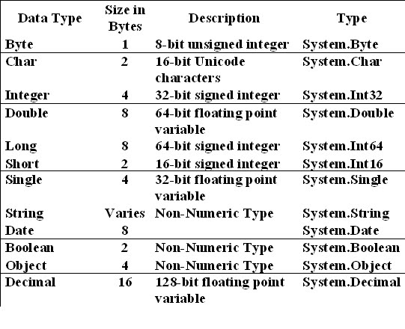
Lecture context
Be familiar with the data types in VB2010 and how to use them
Be familiar with the concept of ‘scope’ and how it helps programmers avoid accidently overwriting data
Understand how to create an array of data
Be able to iterate through an array to fill or investigate its contents

Slide 4
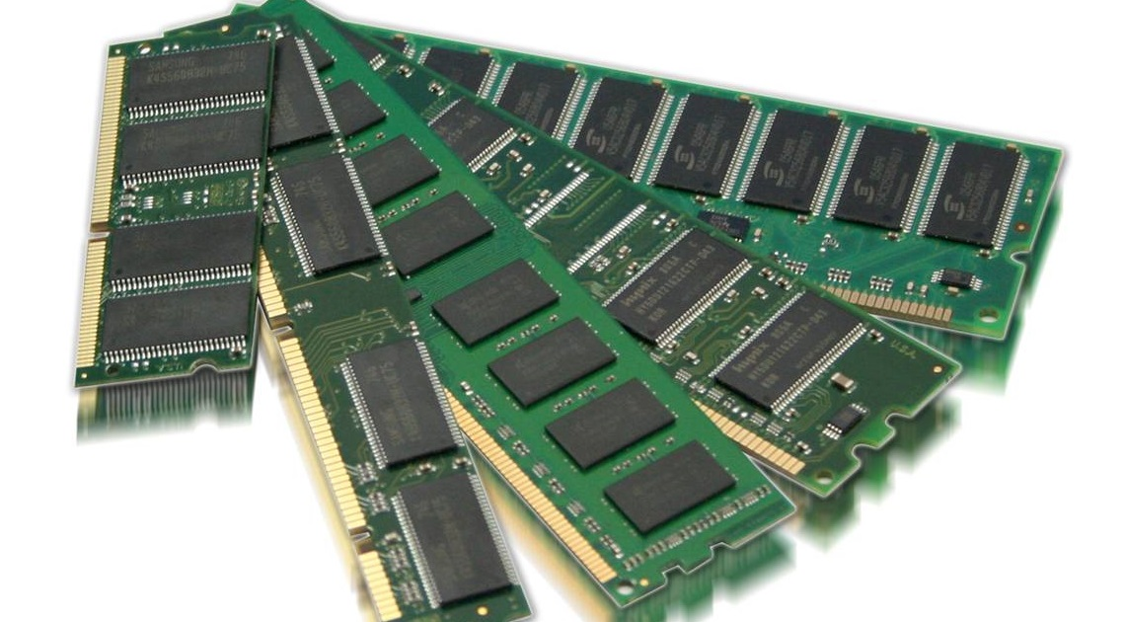
Lecture context
Programs use memory (RAM) to store data and actually run (they are hosted in memory when running). Engineering applications typically use a lot of memory and store a large number of data, typically contiguous time-sampled data in instrumentation applications.
To efficiently utilize memory and ensure no data errors occur, it is important to understand the various variable types available to the programmer.
Also, it is useful to understand how to store ‘clumps’ or ‘groups’ of data and manipulate them as a single entity. This lecture looks at how data is stored, how to limit accidental overwrites and how to manipulate it in arrays.

Slide 5
What variables can store
99.999% of programs work on data of some sort, usually both manipulating and storing it
Part B Matlab/C# modules introduced students to variables: referred to as data ‘Types’
Data containers of varying size and ‘shape’
VB supports the same variable Types as all other common languages
Numeric data types store numbers, that can be treated as numbers, i.e. +-/* SQRT and so on
Visual Basic 2010, C++, C#, F# etc. divides these into 7 types, depending on the range of values they can store and memory they use

Slide 6

What variables can store
Most code uses Integer Type as the most efficient type: only hold +/- whole numbers
Double Type used for Maths and high precision – all Maths Functions such as Sin, Tan, SQRT etc. require Doubles
Decimal Type stores values with highest range and precision
Text is stored in a String Type – NB the characters “3434” stored in a String is NOT a number, it is a string of characters = a ‘word’

Slide 7
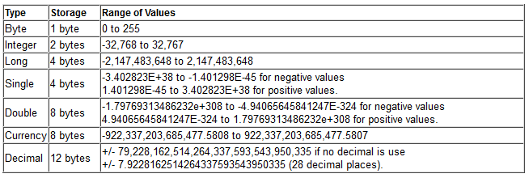
Numeric types
e.g. Dim intLoopCounter as Integer

Slide 8
Non-Numeric types
e.g. Dim myOutcome as String

Slide 9
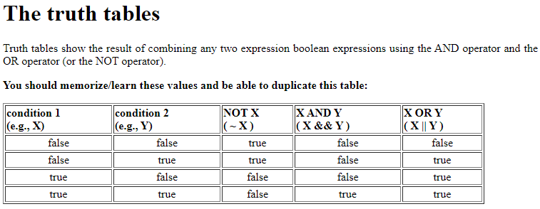
Truth tables
e.g. True And False should return False

Slide 10
Variable scoping
Scope of Procedural declaration is the Procedure – i.e. Private Sub to End Sub
Local variables created at the Dim line and then destroyed at End Sub – re-use resources
Scope of Global declaration is all code across the whole Form – created when program first runs and destroyed when program ends
Procedural declaration
immediately after ‘Private
Sub’ – scope is ONLY the
procedure itself
Global declaration
immediately after ‘Public
Class’ – scope is ALL
procedures on Form Class

Slide 11
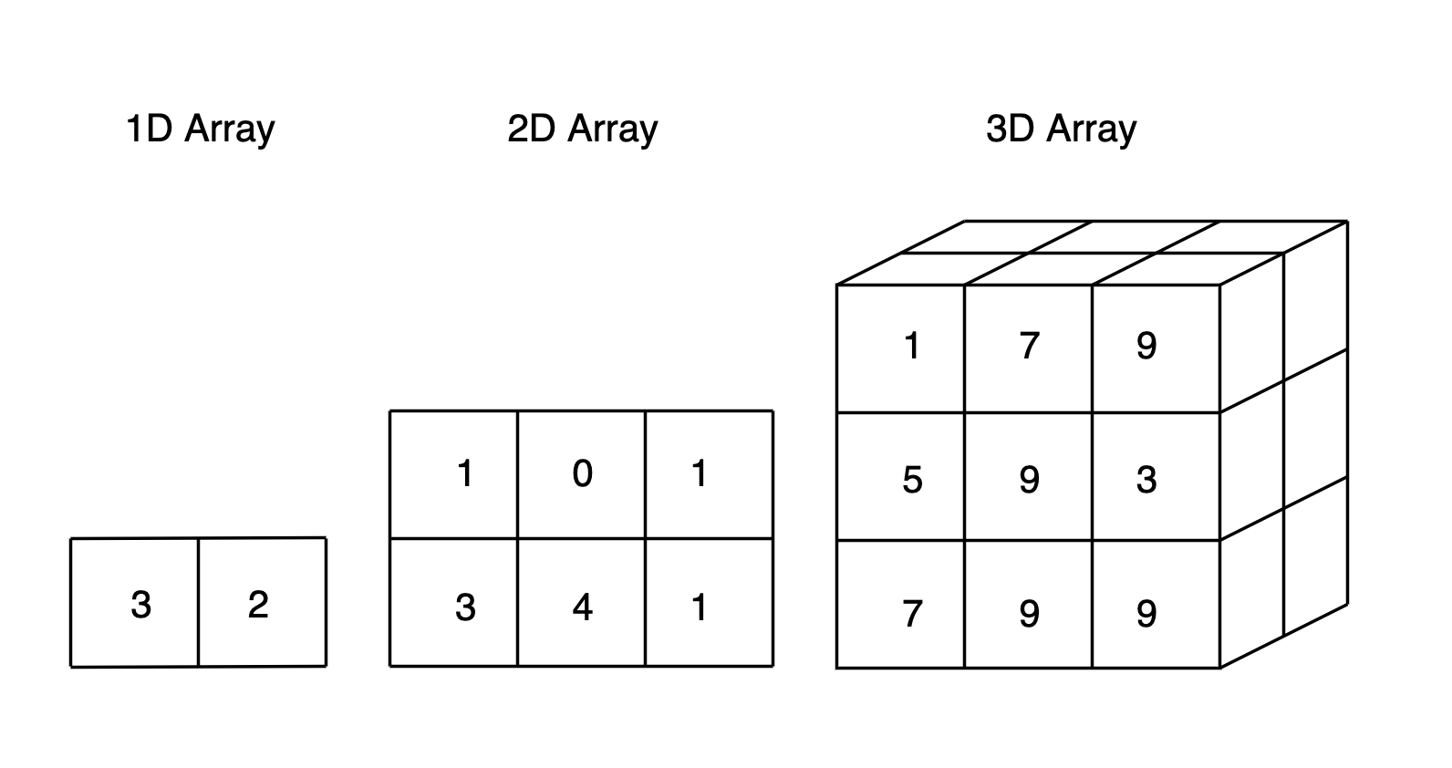
Grouping variables
Large programs might require 1000+ variables – easily introduce errors and difficult to track!
Engineering applications in particular often deal with 1000s of measurement or model data
Difficult to keep track of, and name that many individual variables and errors may appear
Manage them by grouping and/or limiting their Scope across the application
In visual basic and a lot of other programming languages it is treated a group of Types

Slide 12
Grouping variables
An Array is a group of variables that contains a set of data items of same type and name
Arrays have a Name, Type, Size and Dimension
e.g. Dim intData(n) as Integer
Stored data is accessed by index (n) where n is the index of the last cell (n+1 cells)
Range = from LowerBound to UpperBound where UpperBound is index of last cell (n)
We can use single or multi dimensional: 2D arrays are common for measurement data and images and have Rows and Columns

Slide 13
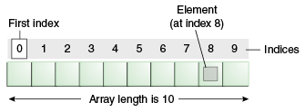
Array indexing
May be declared as dynamic with no initial defined range allowing array to size to data
Size changes by re-dimensioning at each use to fit data: typically using an incremented variable E.g. Dim intDataArray() as integer
Before use, re-dimension ReDim intDataArray(intArraySize)
intArraySize = intArraySize + 1 ‘increase index pointer ready for next loop
ReDim sets array to zero – use Preserve keyword to retain data on ReDim

Slide 14
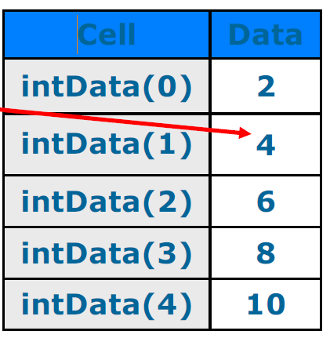
Array visualization
A 1 dimensional array may be visualized as a single spreadsheet column E.g. Dim intData(4) as integer
Contains 5 (4+1) contiguous integer elements
May fill cells with data thus: intData(0)=2, intData(1)=4,
intData(2)=6, intData(3)=8,
intData(4)=10
Dim intData as Integer = {2,4,6,8,10}

Slide 15
Code to fill array with data
Usual method is iteration (mostly For loops are generally used
when one knows the size)

Slide 16
Code to fill a dynamic array
- Note use of Preserve Keyword to prevent all cells being set to zero during array ReDim

Slide 17
Working with bounds
One may work with Upper or Lower Bounds rather than known values: good for dynamic arrays when size is not always known
Use GetUpperBound() or GetLowerBound() Methods to find array size
Use 0 as argument for 1D and 0 or 1 for 2D

Slide 18
Working with bounds
Using Upper and Lower Bounds makes code changes easier to implement
When one changes the size of a static array declaration, one doesn’t then have to change all loop limits within the actual code

Slide 19
Hands on Exercise
We will practice our truth tables
We will use this concept a lot in our work
No | Operations | Outcome
1 | True or True
2 | True or False
3 | True And False
4 | True And True
5 | True or False or True
6 | True And True And False

